Slide 1
CLOUD workshop – IT Filere
c0
SGGSC

Slide 2
Table of contents
SET-UP your cloud environment - 20’’
GET YOU A PLAYING FIELD
FAMILIARIZE WITH ESSENTIAL CONCEPTS
Cloud transformation - Context setting - 20’’
SG GO TO CLOUD
CONSIDERATIONS FOR CLOUD ADOPTION
Hands-on lab - 60’’
CREATE A LINUX VM IN AZURE CLOUD
CREATE POSTGRESQL DATABASE
4. DISCUSSION - 10’’
5. NEXT STEPS - 10’’

Slide 3
setting your sandbox cloud environment
1.

Slide 4



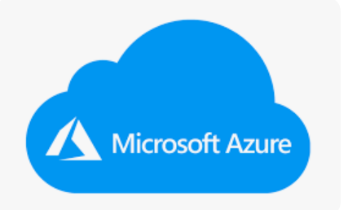



TOOLS you will use today
Video conferencing and Chat
https://www.pluralsight.com/
Technology skills learning platform
OR
Public Cloud provider
https://portal.azure.com
Collaborative version control platform
https://github.com/
https://github.com/pathaksatyan/AzureCloud101/tree/IT-Filere-Cloud-Nov-2022
Notepad

Slide 5
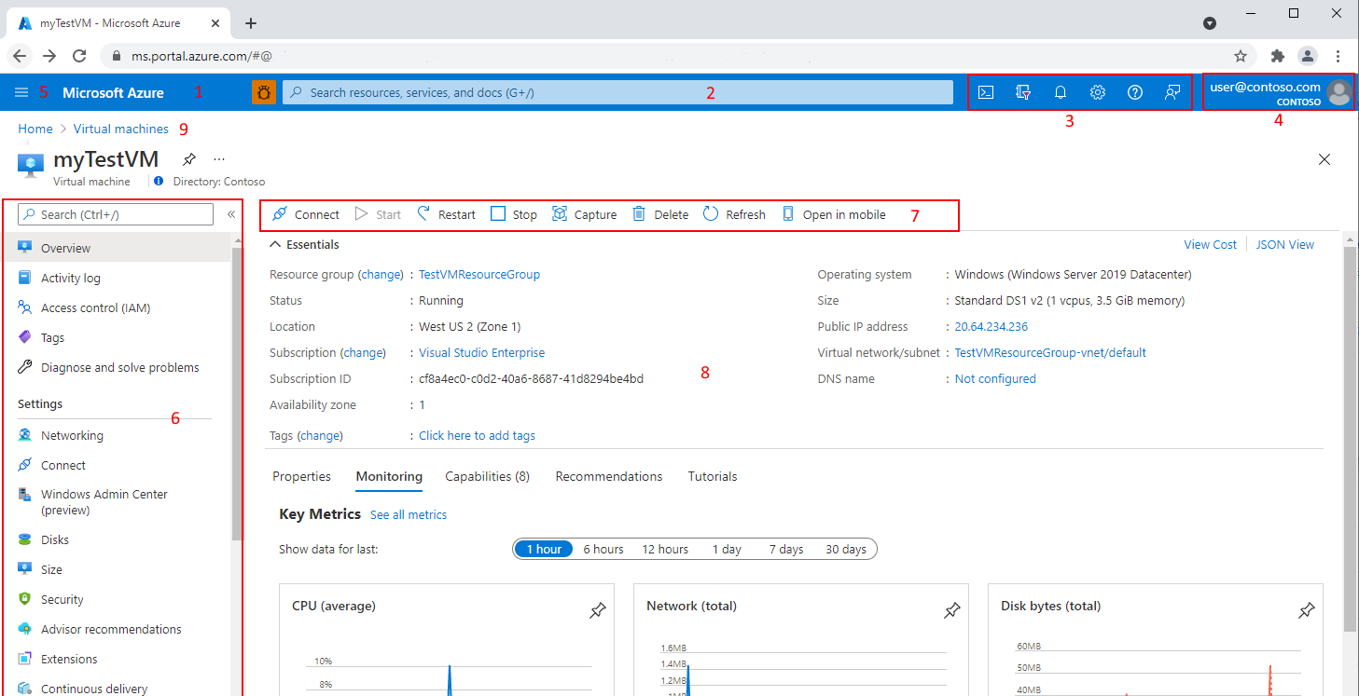
Azure portal – 1 / 2

Slide 6
Azure portal – 2 / 2
Key | Description
1 | Page header. Appears at the top of every portal page and holds global elements.
2 | Global search. Use the search bar to quickly find a specific resource, a service, or documentation.
3 | Global controls. Like all global elements, these features persist across the portal and include: Cloud Shell, subscription filter, notifications, portal settings, help and support, and send us feedback.
4 | Your account. View information about your account, switch directories, sign out, or sign in with a different account.
5 | Azure portal menu. This global element can help you to navigate between services. Sometimes referred to as the sidebar.
6 | Resource menu. Many services include a resource menu to help you manage the service. You may see this element referred to as the left pane. Here, you'll see commands that are contextual to your current focus.
7 | Command bar. These controls are contextual to your current focus.
8 | Working pane. Displays details about the resource that is currently in focus.
9 | Breadcrumb. You can use the breadcrumb links to move back a level in your workflow.

Slide 7
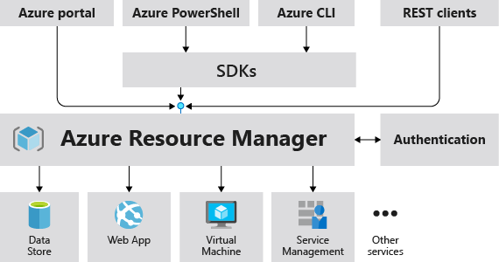
Creating and managing resources in azure

Slide 8
Cloud transformation
2.

Slide 9

HOW TO GET STARTED ?
START WITH A WHY ?
DRIVERS FOR CLOUD MIGRATION
What Business goals do you want to accomplish ?
Business transformation: cloud technology helps simplify business transformation and increase the speed of innovation and agility.
Cost reduction/avoidance: cloud technology, when implemented correctly, helps cut down the cost of your IT. PAYG model enables enterprises to utilize resources for as long as it needed.
Risk reduction:
Cloud technology strengthens security posture , satisfy regulatory requirements and compliances. Centralized management of security vulnerabilities, end of life for hardware components
Provides backup & resiliency
What Technical goals do you want to accomplish ?
CATALOG / INVENTORY
CREATE YOUR BUSINESS CASE

Slide 10

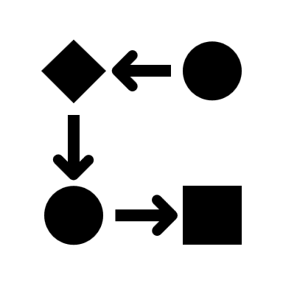

CLOUD ADOPTION
PEOPLE
PROCESS
TECHNOLOGY
Reskilling teams & leaders
Future Roles
Investing in Talent
Operating Model
Organization design
Cost monitoring
Data
How to Migrate ?
Technology choices
Architecture & Design
Security

Slide 11
Top challenges in large transformation’s
1
Transforming culture and ways of working
4
Overcoming technological challenges & skills
3
2
Establishing a clear vision
Lack of leadership

Slide 12
LABS
3.

Slide 13






LAB 1 – create a vm using azure portal
[1] Create Linux Ubuntu Virtual Machine
Laptop
https://portal.azure.com
LINUX VM
[2] SSH into Vm
Cloud Shell (bash)

Slide 14
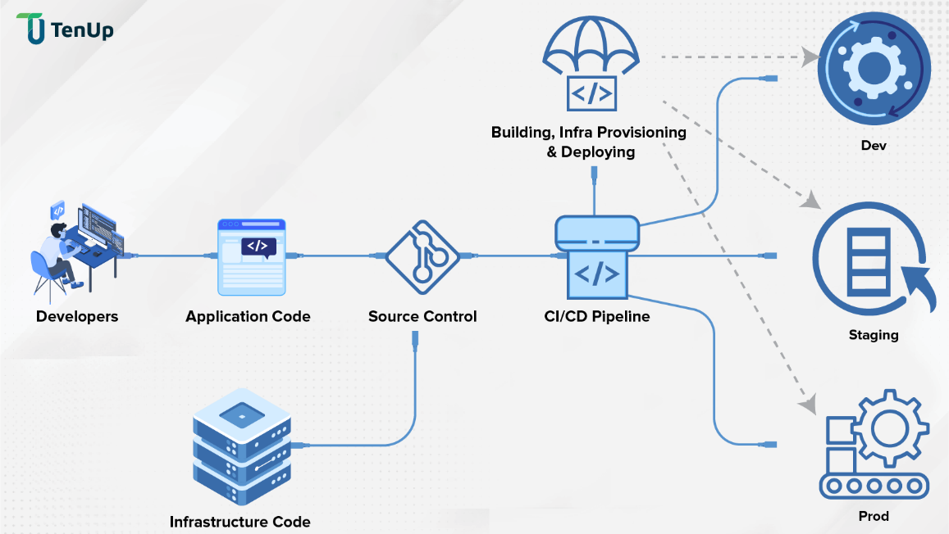
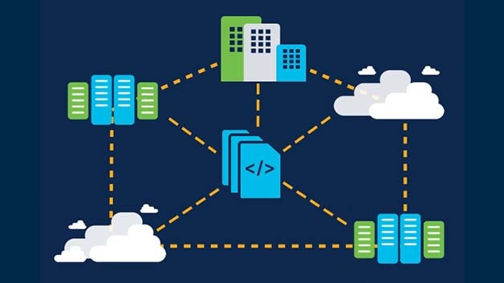
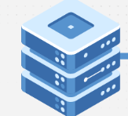
DEVOPS & Infra as code
Repeatable and consistent Infrastructure
Agility and speed of deployment
Documented & version controlled

Slide 15

LAB 2 – Infra As CODe (IAC)
[1] Create Postgresql DB server using Template (ARM)
Cloud Shell
(bash)
Laptop
https://portal.azure.com
[2] SSH into Vm
[3] Install postgresql Client
[4] Connect to the postgresql DB server
Command Line
LINUX VM

Slide 16
COST OPTIMIZATION TECHNIQUES
Right-Size your Compute & Storage resources
Provisioning : Automate provisioning of your environments thru IaC
CI/CD: Use pipelines to automate your build, test, deploy and provisioning thru CI/CD pipelines
Right Architecture and Design patterns
Monitor your resource consumption patterns and cost

Slide 17
Next steps
4.

Slide 18
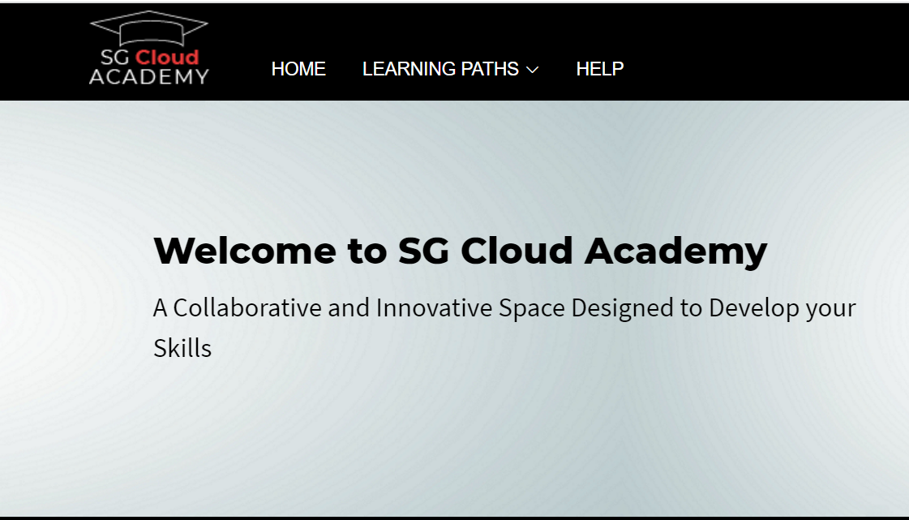
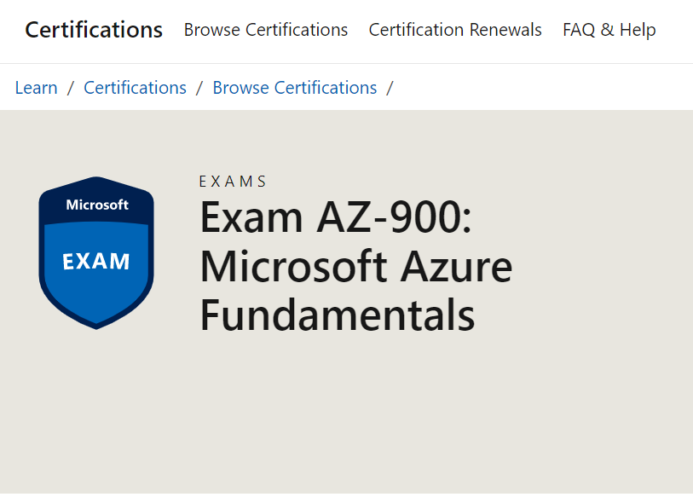
Continue your learning
https://learn.microsoft.com/en-us/certifications/exams/az-900
http://go/sgcloudacademy

